Slide 1

Welcome
Annual Membership Meeting
June 17, 2014

Slide 2
Agenda
Eastern Times
1:00pm—1:15pm Election of Board of Directors—Bjorn Claeson, Executive Director
1:15pm—1:25pm Welcome & Highlights of Consortium Activities—Michele Reale, State of New York, President, SPC
1:25pm—2:00pm Cooperative Sweatfree Contract for Uniform Management Services—Monette McGuire, City of Madison, Wisconsin; Bjorn Claeson
2:00pm—2:20pm Open Session: Successes and Challenges in the Sweatfree Movement—Open to all
2:20pm—2:40pm Wage Theft in Haiti?—Yannick Etienne, Coordinator, Batay Ouvriye
2:40pm—2:55pm New Developments: Sweatfree Electronics—A Possibility?— Pauleen Overeem, SOMO and Elecfronics Watch
2:55pm—3:00pm Closing Comments—Prof. Robert J.S. Ross, Vice President, SPC

Slide 3

Cooperative Contract
Request for Proposals:
Pilot Sweatfree Cooperative Contract for Uniform Management Program
Monette McGuire, City of Madison
Board Member, Sweatfree Purchasing Consortium

Slide 4

Cooperative Contract

Slide 5
Cooperative Contract
RFP Timeline
Date / 2014 | RFP Activity
May 1 | Release of RFP
May 23 | Written questions are due
May 30 | Supplements, Revisions and/or Responses to Written Questions will be posted on DemandStar and Vendornet web sites
June 13 | DEADLINE for Submission of Bidder Disclosure Statements and Uniform Samples
July 31 | Notification to Vendors of Compliance with Minimum Qualification Threshold and Approved Uniform Samples
August 22 | DEADLINE for Submission of Technical and Cost Proposals
September 28 – October 4 | Vendor Interviews/presentations, if applicable
November - December | Contract Negotiations Approval, Award and Contract Signing
January 1, 2015 | Anticipated contract approval and start date

Slide 6
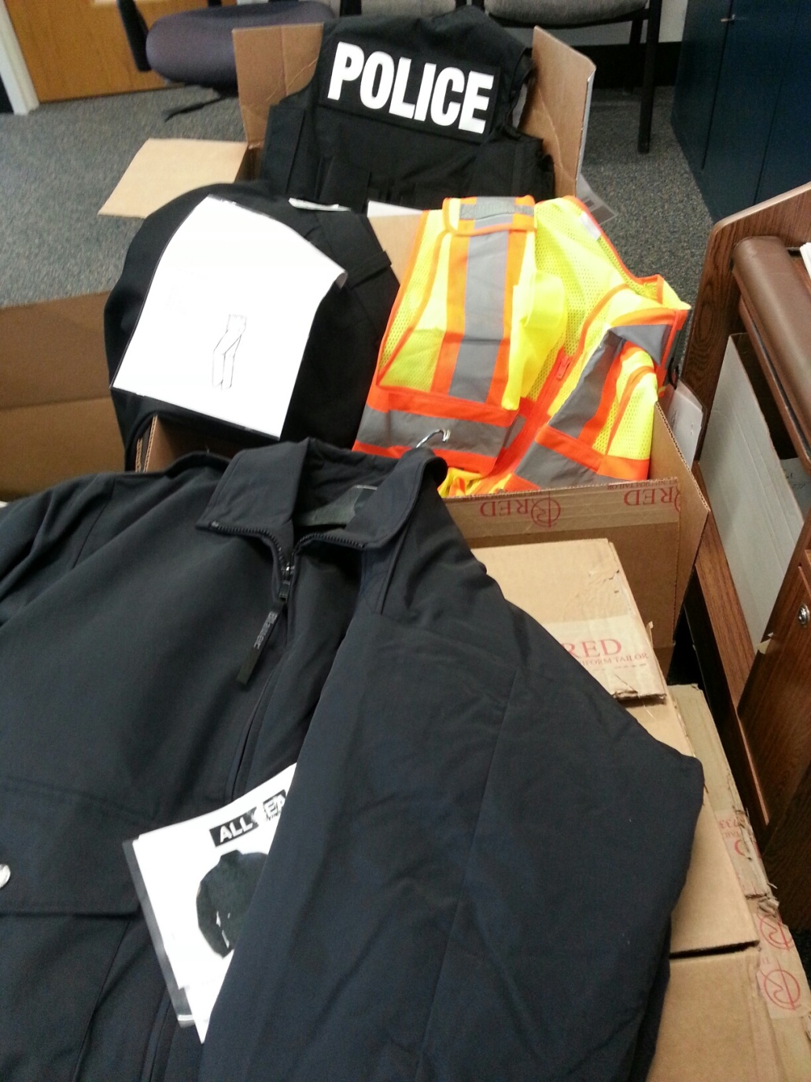
Cooperative Contract
Apparel Samples

Slide 7
Cooperative Contract
Products:
Public safety, general trade, supervisory and dress apparel, t-shirts and cotton wear used by Fire, Metro Transit and other municipal operations agencies
Contract value:
$500,000 by City of Madison
Cooperative contract:
Available to City of Madison agencies and other public sector entities
Contract term:
Three years plus two one-year terms

Slide 8
Cooperative Contract
Goals
Pragmatic Approach
Recognizing that … labor violations are inherent in the apparel industry, it is the City’s intent to implement a pragmatic and incremental approach to achieve the goals of this sweatfree procurement. The processes and requirements established herein are designed to promote fair and competitive compliance methods… The City also understands that…apparel industry participants, including those who are responsible for the sourcing and purchasing of these products, all bear responsibility and play a role in improving industry conditions and standards; therefore, it is the City’s intent to encourage a concerted cooperative effort to achieve sweatfree compliance. (Section 2.1.2)

Slide 9

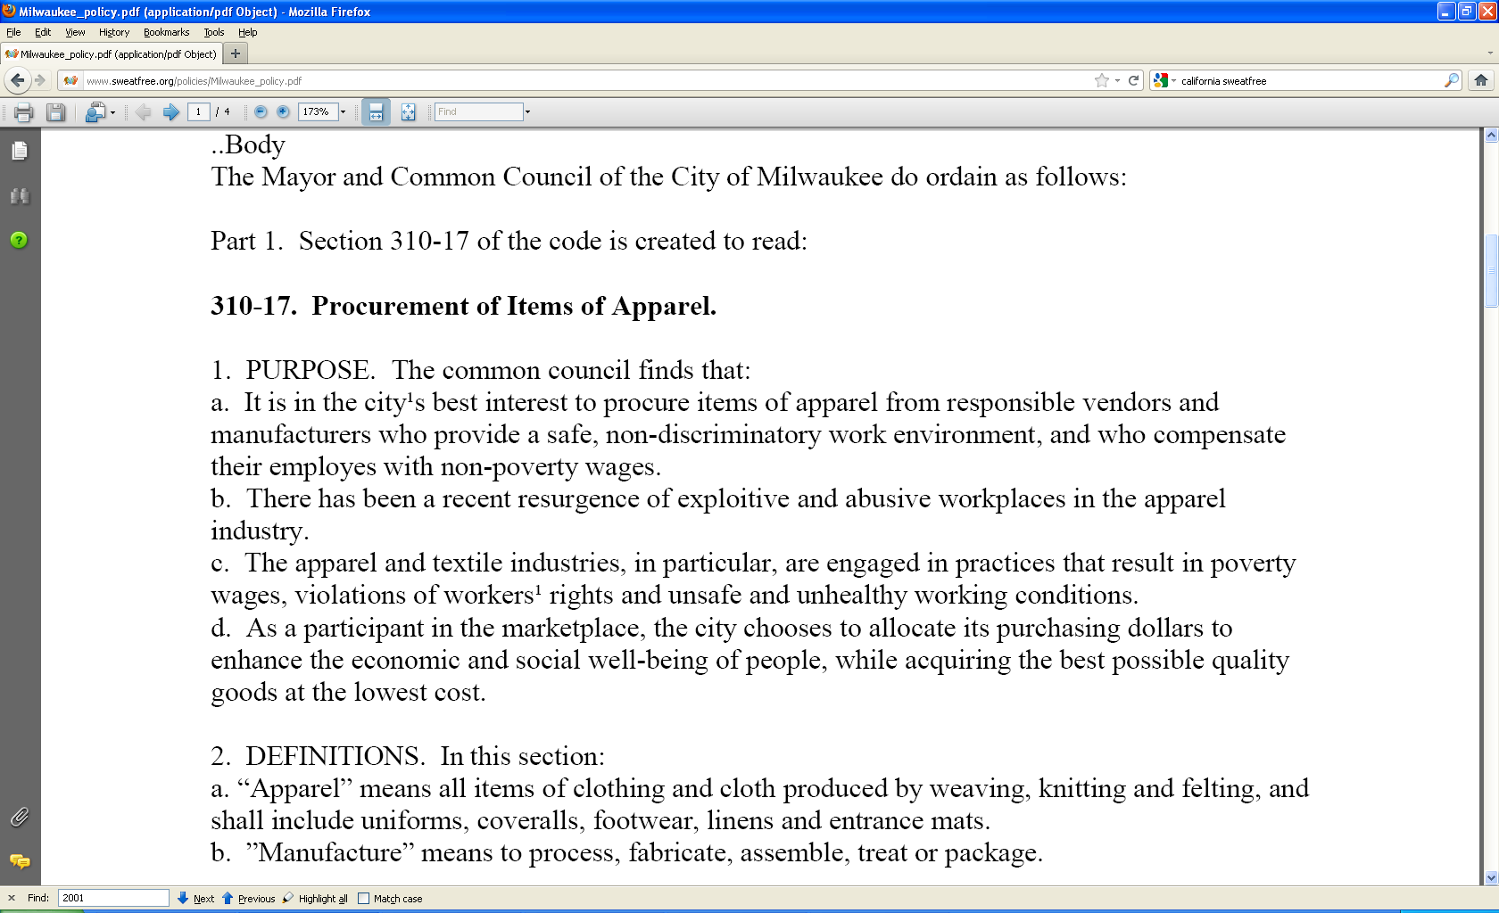
Open Session
Successes and Challenges in the Sweatfree Movement
Open to everyone
Would you like to share experiences?
Do you have questions?
This is your opportunity to make connections and network virutally

Slide 10
Wage Theft in Haiti?
Yannick Etienne, Coordinator,
Batay Ouvriye
Jessica Campagne, Director of Research and Advocacy,
Worker Rights Consortium

Slide 11
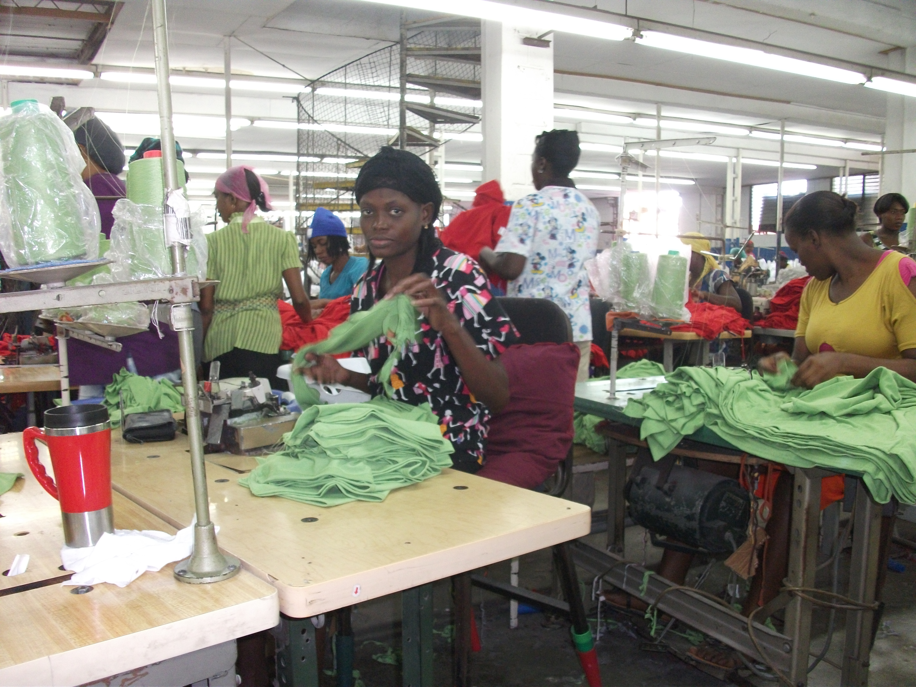
Minimum Wage Violations in the Haitian Apparel Industry

Slide 12
Current Minimum Wage Law
Two tiered wage system:
  Floor or “reference” wage of 225 HTG (US$5.71) per day
    Applies to workers paid per day and trainees
  Production minimum wage of 300 HTG (US$6.98)
    Applies to workers who are paid based on production
    Factories must set piece rate to ensure that most non-trainee workers earn 300 HTG in an eight-hour day

Slide 13
Documented Non-Compliance
Non-compliance widespread since the law went into effect in 2009
Better Work program found increasing non-compliance:
61% (April 2011)
91% (October 2011)
90% (April 2012)
95% (October 2012)
100% (April 2013)
100% (October 2013)
91% (April 2014)

Slide 14
WRC Findings
Widespread errors and lack of transparency in pay systems
Piece rates set so low workers are unable to make the minimum daily wage even by working overtime
Excessive overtime, often “off the clock”

Slide 15
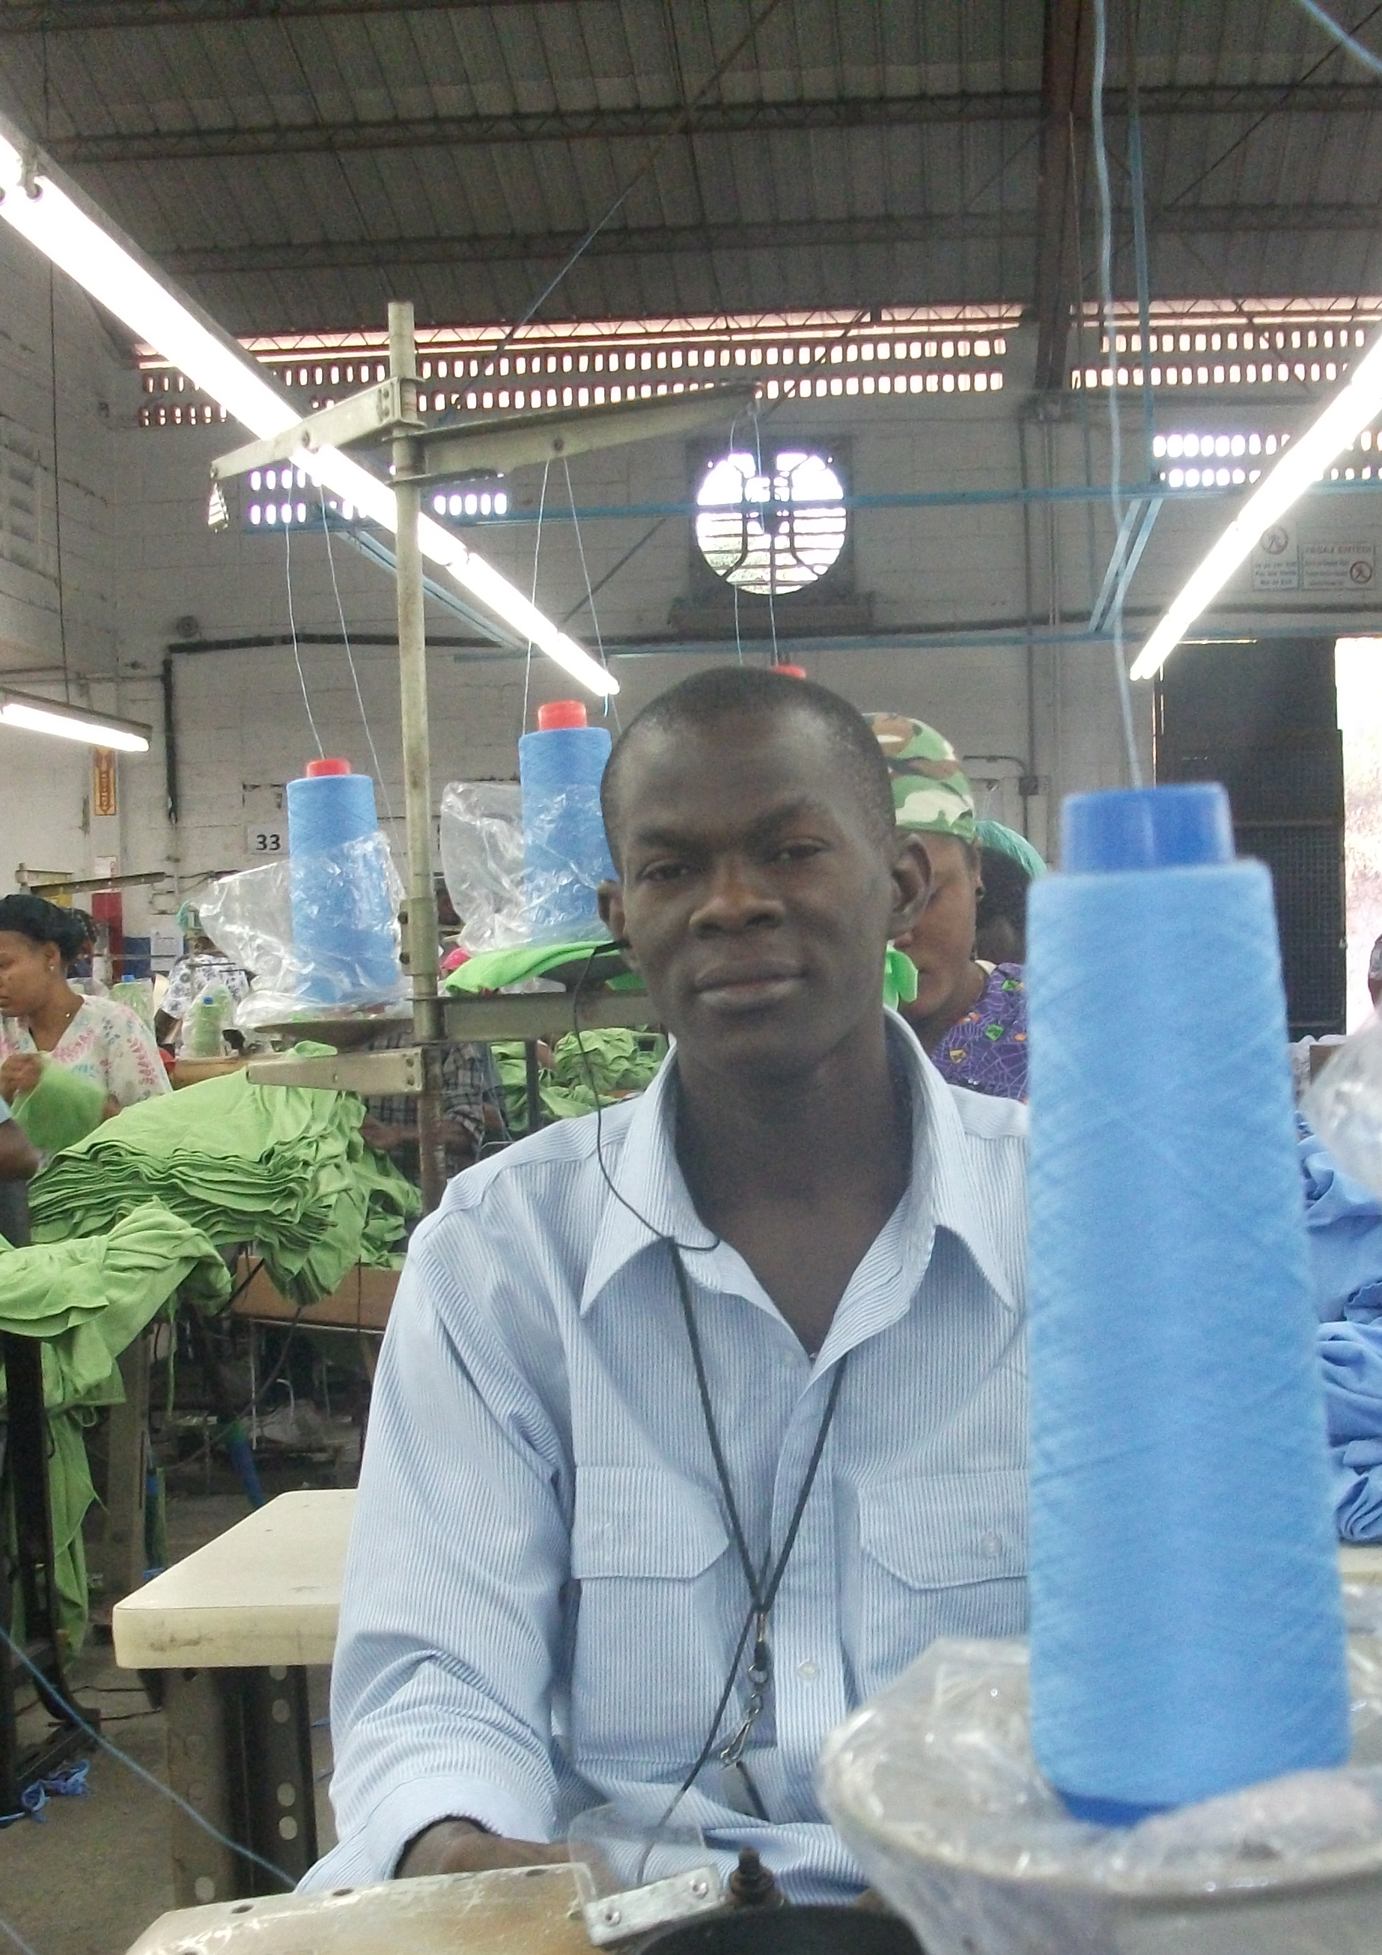
Overtime
Average workday of 9.7 hours, excluding breaks
Overtime is often unpaid or underpaid – and often involuntary.
With overtime, workers earn 270 HTG (US$6.28) on average
  Less than the legal requirement for just an eight-hour day
  32% underpayment

Slide 16
Cost of Living
After working 10 hours per day, 6 days a week, a worker and her family would still be below the internationally recognized line of “extreme poverty.”
Workers are spending only 1/3 of the amount necessary to meet basic needs.
Workers are forced to forgo essential food, shelter and medical care.
Cycle of debt: Workers’ average wages are only 76% of their reported expenditures.

Slide 17
New Living Wage Report
Solidarity Center April 2014
Uses WRC methodology
Living wage: 1,006 HTG ($23.34) per day
Piece rate (300 HTG) minimum wage is less than 1/3 of living wage.

Slide 18

Food Insecurity
More than ¾ were unable to afford three meals a day for themselves and their families
The cost of decent food is more than double workers’ monthly take-home pay.
71% needed to borrow money to pay for food

Slide 19
Food Insecurity
“…here is how it works when we work in the factories: we know how much we will earn before the payroll. And we must pay debts. So we are obliged to suffer in order to pay those obligations. We can spend the whole year having only one meal a day. That is the same suffering every day. I never have three meals a day.”
Haitian garment worker

Slide 20
Medical Care
100% of workers reported that over the past year they were unable to seek medical attention for at least one dependent due to lack of available funds.
Almost 50% of workers reported having to take out loans in order to obtain medical services

Slide 21
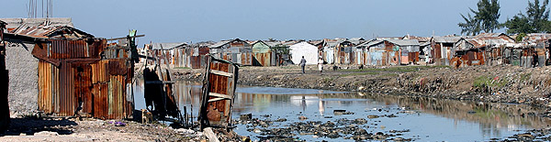
Shelter
Over a third needed credit or loans in order to pay for rent or shelter.
Workers unable to access credit or affordable loans and rely on extremely high interest loans.
Many workers have no running water and erratic electricity.

Slide 22
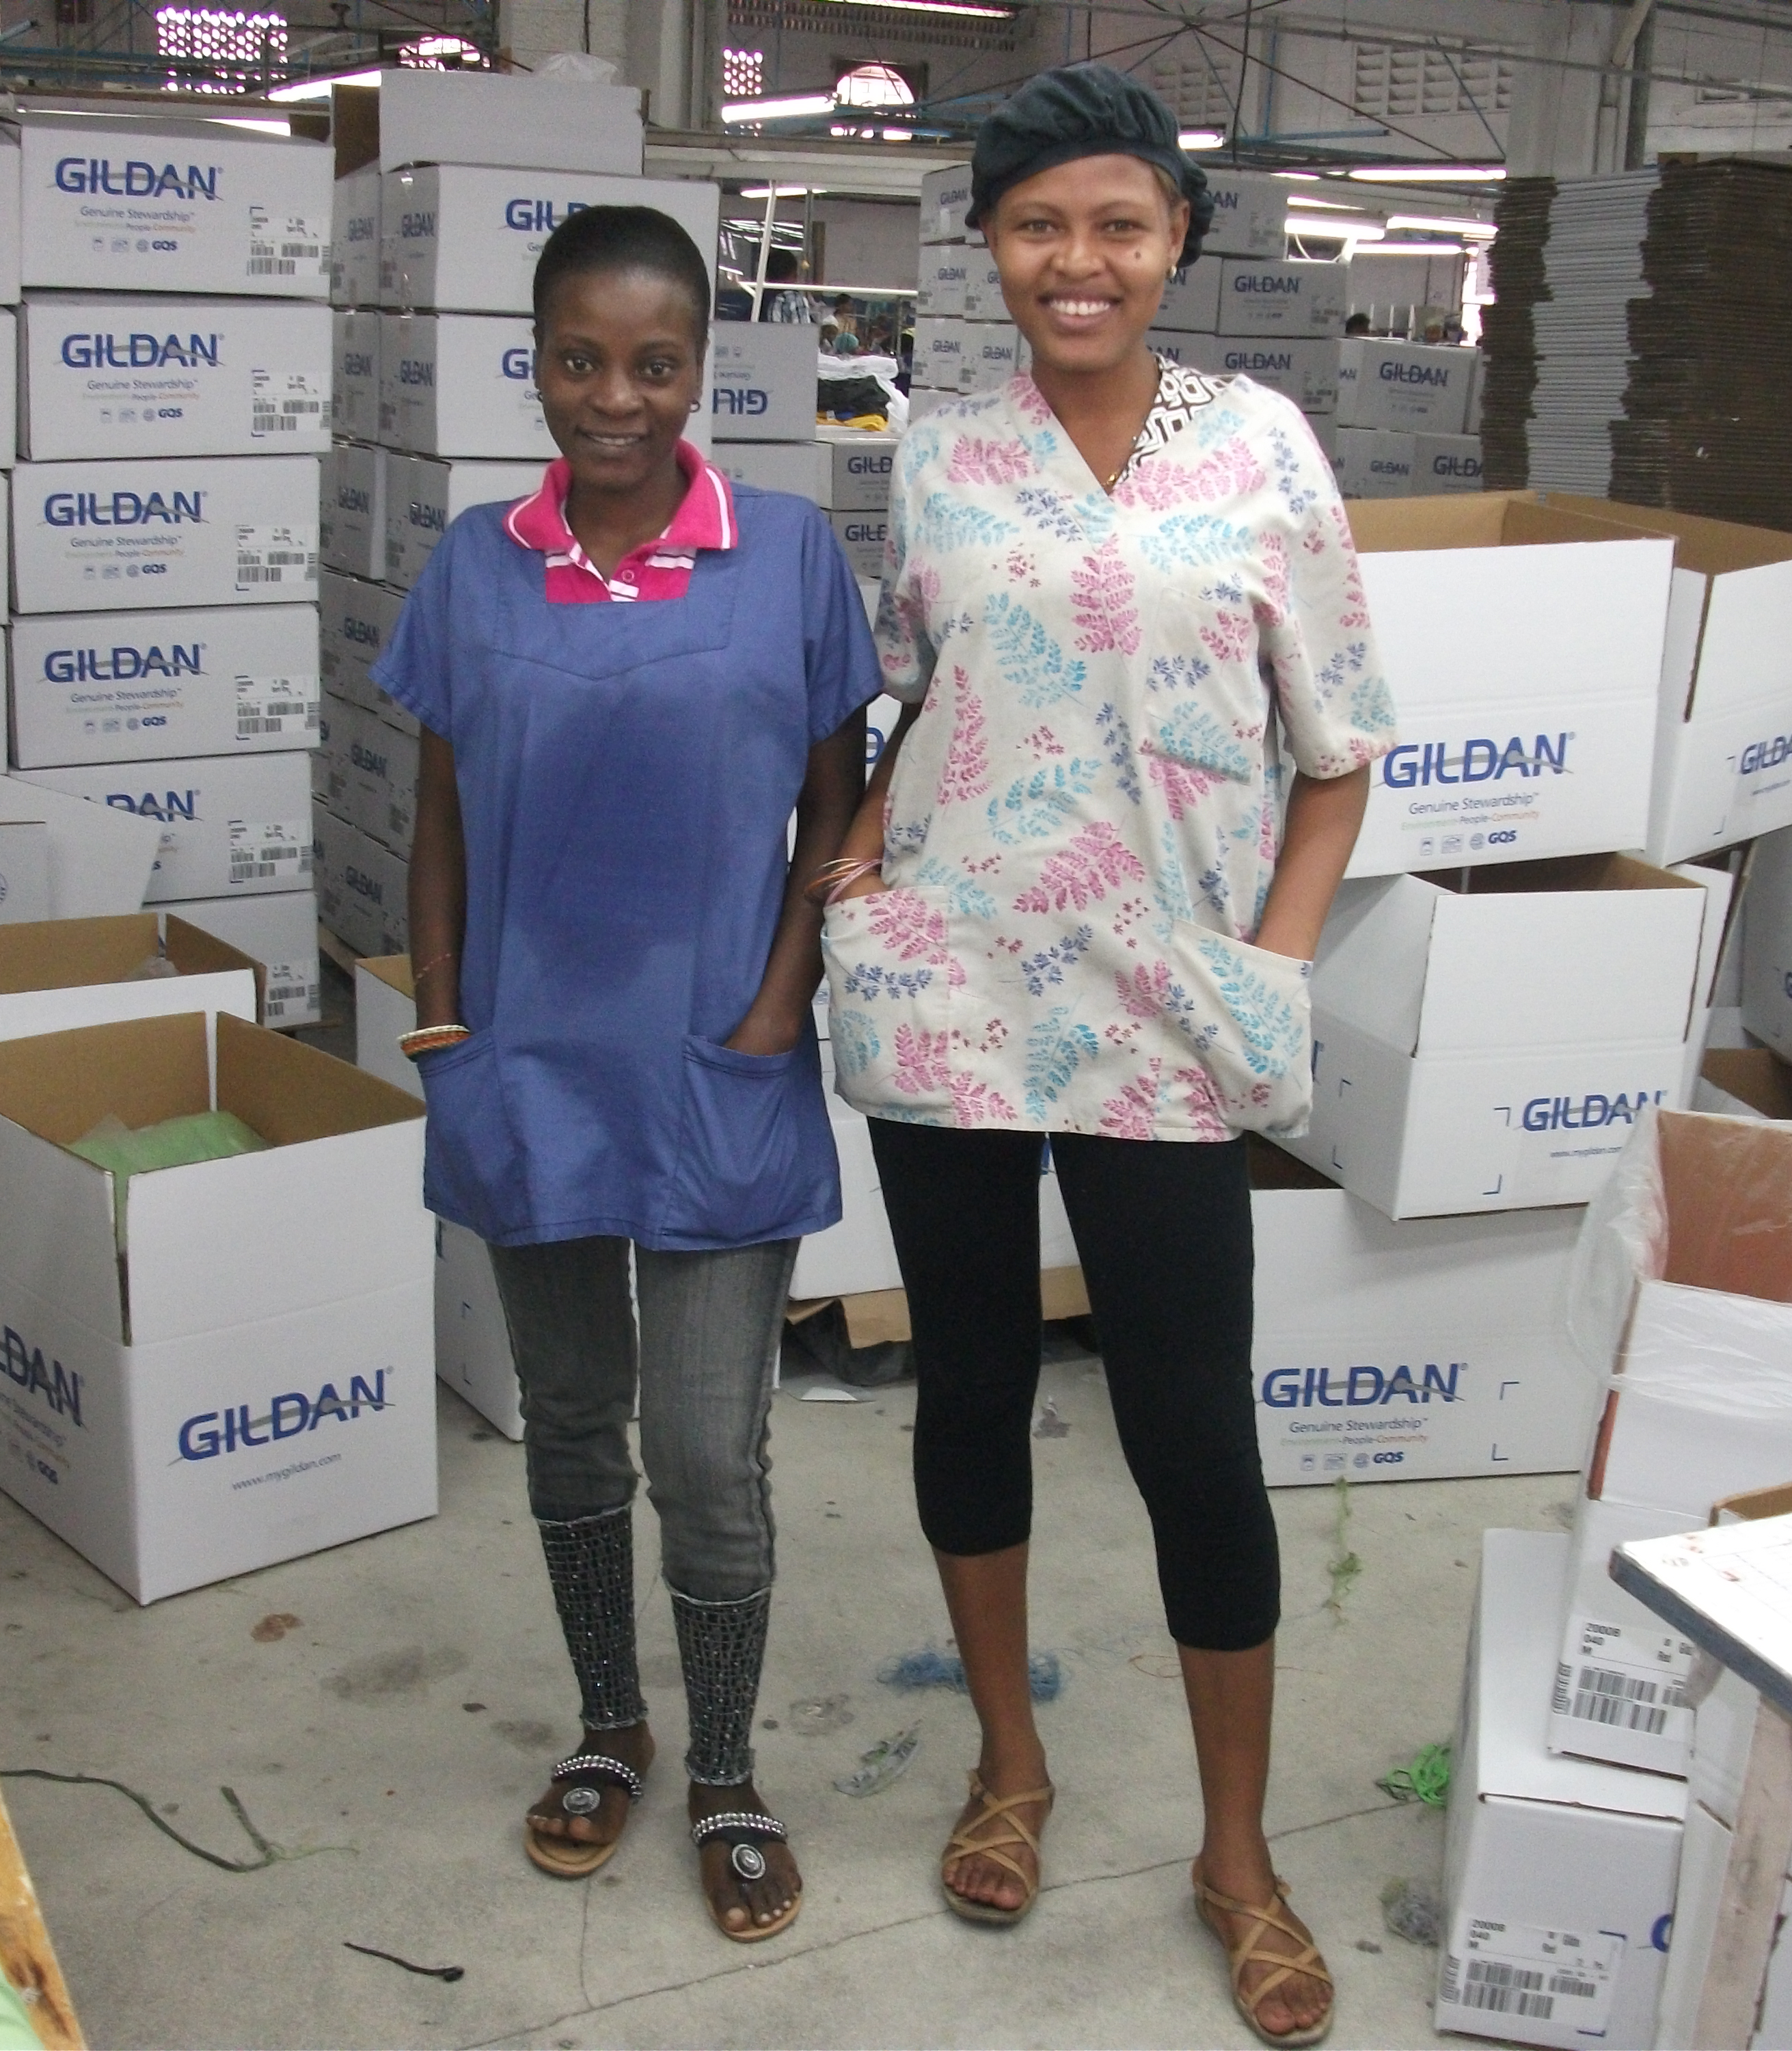
Recommendations to Brands
Full compliance with the minimum wage, with prices paid to factories adjusted accordingly
Full compliance with payment of overtime
Back pay with interest
Continued production in Haiti

Slide 23



Key Buyers
Factories producing for these three brands employ 60% of the workers in the Haitian garment sector
Notes:
Why these buyers? Biggest – power to set the standard

Slide 24
Engagement with buyers
Fruit of the Loom, Gildan make public commitment to ensure workers receive 300 HTG
Hanes makes private commitment to ensure workers receive 300 HTG
All three brands meet with Haitian unions on January 10 in Washington, DC.
  WRC facilitates
  U.S. Department of Labor observes
  Discuss agreement re implementation, verification
Further dialogue ongoing….
Notes:
First, encouraged these firms to make public commitments as an initial step towards resolution.
Then, encouraged them to sit with people representing workers to reach an agreement on implementation. Such an agreement is the best form of resolution and the most likely to lead to ongoing compliance for several reasons.
1. Clear, detailed commitments and ensures a shared understanding of what full compliance requires
2. Transparency and verification procedure
3. Accountability

Slide 25
Current Status
Fruit, Gildan, Hanes have communicated to suppliers that workers must receive 300 HTG per day.
Suppliers report that Fruit and Hanes have accepted need for price increases.
Codevi (supplier to Fruit and Hanes) has signed an agreement with the union (June 10).
Better Work Haiti continues to report that most workers are not receiving 300 HTG per eight hour day.
No commitment on back pay from Fruit, Hanes, or Gildan
Notes:
While we are very pleased that more, although not yet all, workers in Fruit, Gildan, and Hanes suppliers are receiving the wages that they are owed, full compliance will not be assured until these brands sign implementation and verification agreements.
Unfortunately, there has been no progress to date regarding back pay. While the law is clear, it is unclear whether the brands will move into compliance on this issue.
Worth noting that a number of factory owners have contacted the WRC directly to discuss the law and the challenges of implementation. The WRC has agreed to sit down with all stakeholders in Haiti to ensure clarity regarding these standards and regarding how we will be assessing compliance.

Slide 26


Slide 27
Wage Theft in Haiti?
Questions for Companies
Is your company currently ensuring that all workers earn 300 gourdes per eight-hour day plus appropriate overtime based on the 300-gourde base rate?
Is your company planning to sign an agreement with the relevant unions to ensure implementation of the 300 Gourde base rate?
What steps will your company take to compensate workers for below minimum wage payments at your supplier factories over the past five years?

Slide 28

Sweatfree Electronics?
Sweatfree Electronics—A Possibility?
Pauleen Overeem
Centre for Research on Multinational Corporations (SOMO)

Slide 29

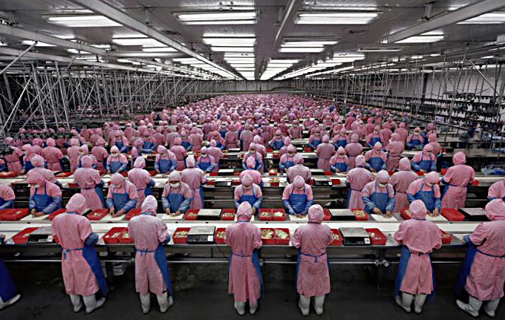

Slide 30
Improving working conditions in the global electronics industry
Through socially responsible public procurement of ICT hardware
Independent monitoring of conditions in production locations
Improvement programmes
Reform of business practices

Slide 31
The electronics industry
The electronics industry is one of the fastest growing industries
Millions of workers worldwide: 1.2 million with Foxconn, 225 thousand with Flextronics.
Despite clean and modern image labour conditions are often sub-standard.

Slide 32
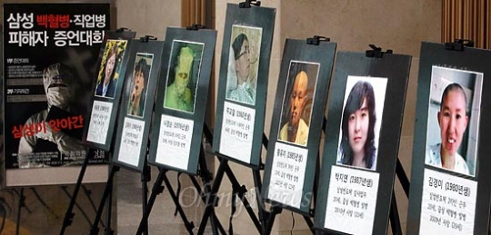
Samsung workers exposed to chemicals

Slide 33
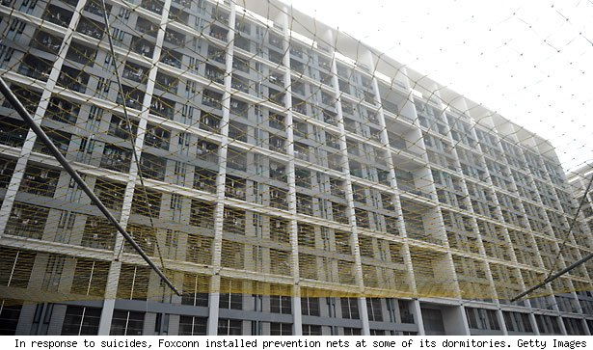
Foxconn installs safety nets in response to suicides
‘Dormitory Labour Regime’
Jenny Chan (SACOM)

Slide 34
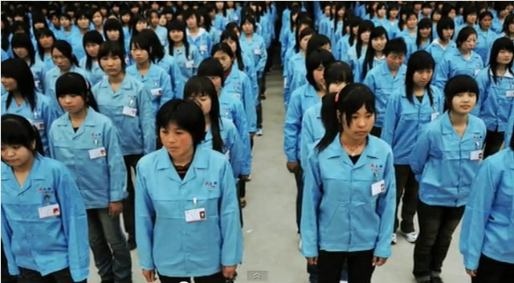
‘Women work like men and men work like machines' – Foxconn slogan

Slide 35
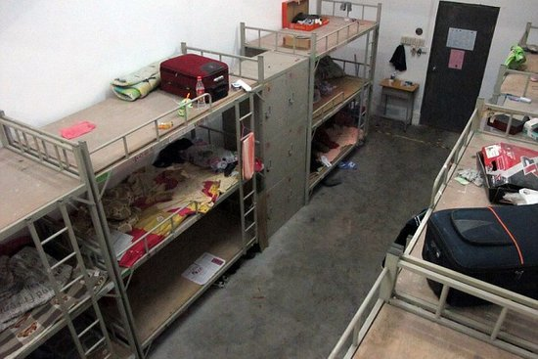
Miserable dormitories for migrant workers
Dentro de uno de los dormitorios de Foxconn

Slide 36
…. a risk sector
Issues with safety and health at the work floor
Low wages
Long hours of work, forced overtime
Temporary contracts, agency labour
Violation of union rights
Exploitation of vulnerable workers (migrants, students, etc.)
Humiliating disciplinary measures

Slide 37

Brands target of campaigns

Slide 38
Industry is not taking the lead
EICC, GeSI
Code of conduct not in line with ILO
Turning cold shoulder on trade unions, stakeholders
Fair Labor Association (FLA)
Apple –Foxconn programme critiqued
Sustainable Trade Initiative (IDH)
Programme (5 brands, 50 suppliers) now ending

Slide 39
3-year project of 7 European NGOs
€1 million funding by European Commission

Slide 40








Slide 41
By 2015, the new organisation will start – Electronics Watch Foundation, based in Amsterdam
Governance is democratic and open
Role for local labour groups
50 public sector organisations (target)
In Europa, and in US (?!)

Slide 42
Process approach, no certification
Supply chain transparency: information about supplier locations
Access to factories
Factory-level improvement programmes
Reform of business practices in the sector – pricing, costing, lead times, etc.

Slide 43
www.electronicswatch.org
Newsletter, reports, video
Identification of local monitors
Advisory Group is active
Founding members:
  Universiteit van Edinburg
  London Universities Purchasing Consortium
Now recruiting for Board o Trustees (until 22 June)
Legal entity (foundation) in the Netherlands

Slide 44
EW offers (services)
Professional support for responsible procurement of ICT hardware
EW Code of Labour Practices
EW contract clauses and standard language to be used in contracts with suppliers
Monitoring and improvement of labour conditions by local monitors
Reporting and database

Slide 45
Public sector: commitment, fee
Subscribe to EW Code of Labour Practices
Use EW contract clauses and language in procurement procedures
Pay annual fee on the basis of procured ICT hardware volume
Keep contact with contractual suppliers over progress of improvement plans
Breach of contract: warnings, penalties,

Slide 46
Reasons for public sector to join
Contribute to improving labour conditions
Contribute to reinforcing local civil society including trade unions
Give hands and feet to public sector sustainability objectives
Participate in network of sustainable public sector organisations in Europe, and beyond
Risk managementnag

Slide 47
Possibilities to get involved
EW newsletter, www.electronicswatch.org
Spread the word, tell colleagues and others about EW
Provide EW with information on current procurement practices
Public sector affiliation (‘Founding Member’)
Join the Advisory Group
Join Board of Trustees (deadline 22 June)

Slide 48
Thank you for your attention!
Any questions?

Slide 49
Wrapping Up
Wrapping Up: Mission and Benefits
Robert J.S. Ross, Vice President
Sweatfree Purchasing Consortium
www.buysweafree.org
contact@buysweatfree.org
240-221-1121

Slide 50

Wrapping Up
Collaboration
Using the collective resources of public entities to move toward more decent working conditions. For example, the cooperative contract which uses our combined strength to raise labor standards AND save money for tax payers by buying cooperatively.

Slide 51
Wrapping Up
Innovation
Creates an opportunity for innovation in the relation of public purchasing and working conditions, e.g., through the new electronics collaboration.

Slide 52
Wrapping Up
Shared Information
Information from the ground—for example the report on wages in Haiti from Yannick Etienne.
Access to data about vendors: http://buysweatfree.org/linkup

Slide 53
Thank you!
www.buysweafree.org
contact@buysweatfree.org
240-221-1121

