Slide 1
SRPP Guidance in Norway
Jenny Ählström
Senior Adviser, Norwegian Agency for Public Procurement and eGovernment
19.10.2012

Slide 2
The Norwegian government’s strategy on socially responsible public procurement
Norwegian Action Plan on Environmental and Social Responsibility in Public Procurement:
“The Government emphasises that the public sector, through its procurement activities, shall be socially responsible through contributing to ethical and socially accountable production, trade and consumption.”
White Paper on public procurement nr. 36 (2008-2009):
“The public sector can also, as an important actor on the market, stimulate ethical business conduct, for instance by requiring its suppliers to conform with fundamental ethical criteria.”
White Paper nr. 10 (2008-2009):
“The Government wishes that production and consumption of goods and services should be as sustainable as possible. Public sector must take the lead through requesting goods produced in accordance with high ethical and environmental standards.”
Agency for Public Management and eGovernment

Slide 3
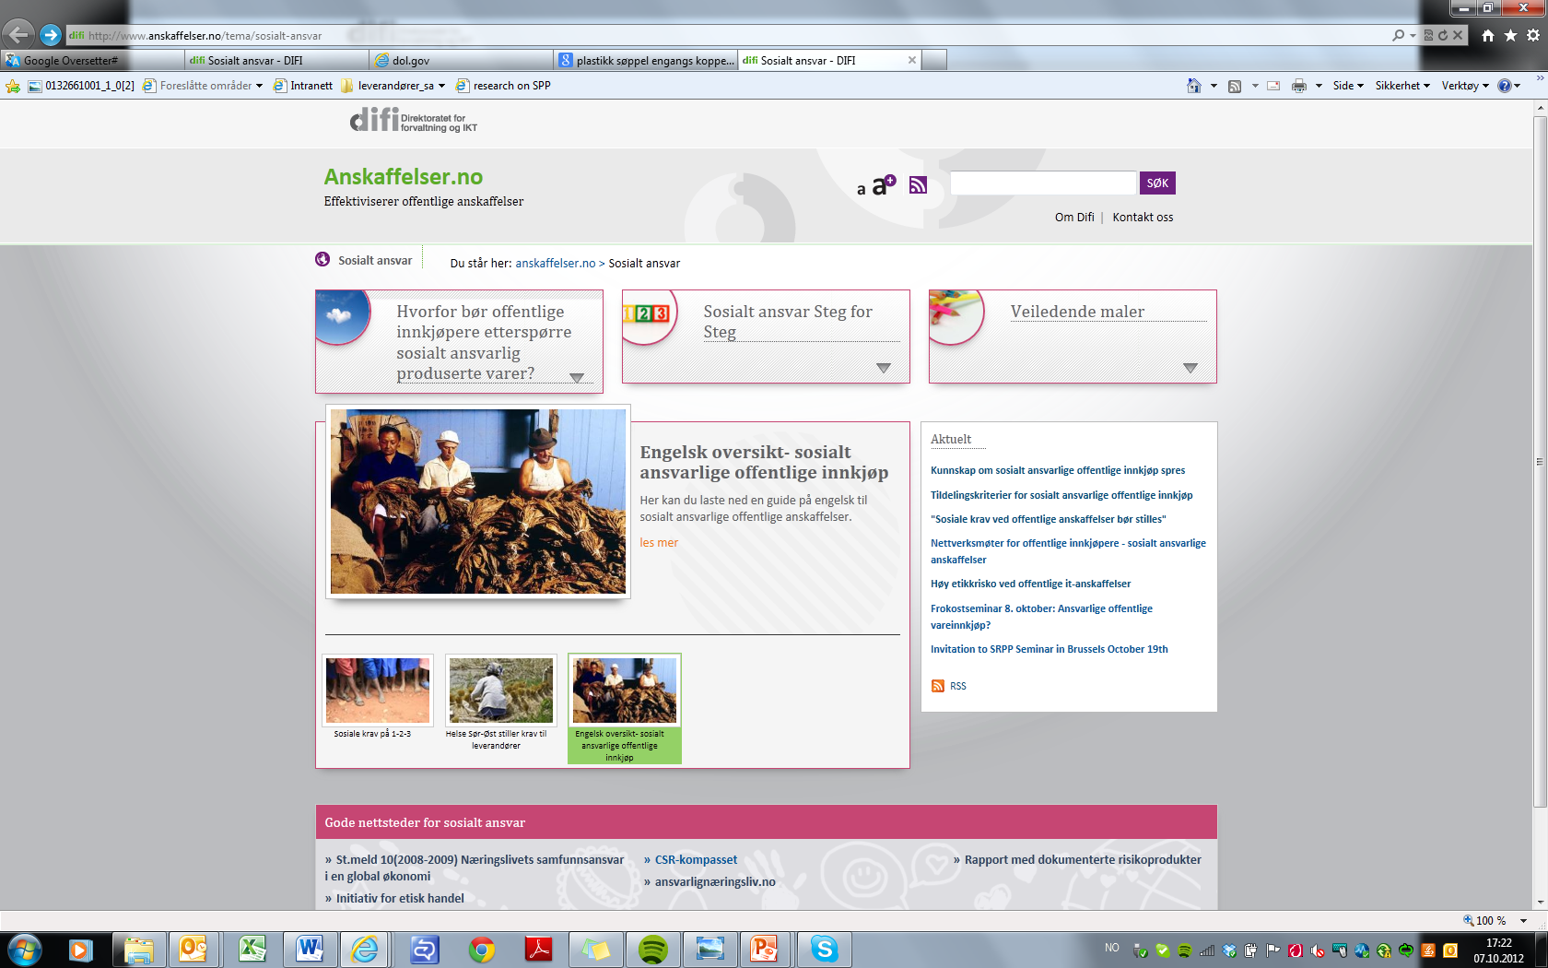

Slide 4
Difi SRPP Guidance:
SRPP Guide: a step-by-step guide on how to request and verify a socially responsible production
List of high risk products: products with documented systematic breaches of ILO core conventions in the supply chain
Special contract clauses: requesting a socially responsible production in line with the ILO core conventions
Self-assessment questionnaire: to follow-up the supplier on socially responsible supply chain management
Notes:
General guidance on how to mainstream SRPP: in order to ensure public procurement to embrace the principles of fair competition, transparency, equal treatment and most value for taxpayers money
Step by step guidance: through the whole procurement process: from procurement planning to following up the contract
High risk product list: this is a list we have devloped in cooperation with the UK CSR consultancy IMPACT – this list contains products with a documented high risk of systematic breaches of ILO conventions and human rights during the production phase. This list is updated continously.
PROPORTIONALITY
4. To ensure transparency and predictability we have SRPP TEMPLATES for the procurers to put directly into the tender documents; and special contract clauses on socially responsible production to be added to the contract of the high risk product procurements. Self-questionnaire to be sent to the supplier in order to ensure equal treatment.

Slide 5
Forthcoming in 2013
Supplier guidance: how suppliers to public sector ensures compliance with SRPP requirements
Guidance on selection criteria: minimum requirements to be met by suppliers to take part in the tender
Guidance on award criteria: giving extra points for the level of socially responsible supply chain mangement systems (weighting social criteria against price)
Facilitating stakeholder dialogue: Arraning seminars and nettwork meetings where private sector, public procurers, NGOs and unions are invited for knowledge- and best practise sharing.

Slide 6
Notes:
Stiller krav både til oss som offentlige oppdragsgivere –
vi skal opptre som enhver annen virksomhet med krav til bunnlinjen – dvs anskaffe det som er forretningsmessig mest lønnsomt for virksomheten.
MEN –det skal være LANGSIKTIG LØNNSOMT. Vi – liksom innkjøpere i næringslivet – kan ikke lengre kun gå ut og etterspørre lavest mulig pris til høyest mulig materiell kvalitet og ikke tenke på under hvilke forhold disse varer er produsert under. Ok, fin bord. Ikke så verst dyr og god kvalitet. Det er viktig. Men hva er kvalitet egentlig? Er det kun den materielle kvaliteten på varen? Nei – sier EU-domstolens generaladvokat Juliane Kokott: Hun lager en metafor om sukker

